Slide 1

COMP-SCI 5590 - 0001 Special Topics
Loop structures, conditional statements, strings, List, Tuples, Functions

Slide 2
Objective
definite and indefinite loops: for and while statements.
interactive loop and sentinel loop: implementations using while statement
Nested loop
Reading from a file in loop
If conditions statements
String formatting
Tupples
Functions

Slide 3
String Formatting
uses C-style string formatting to create new, formatted strings
The "%" operator is used to format
Let's say you have a variable called "name" with your user name in it, and you would then like to print

Slide 4
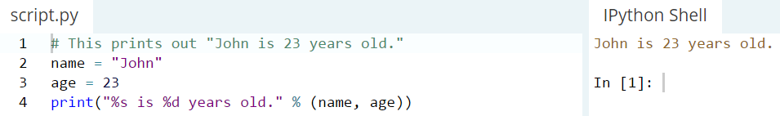
String Formatting: Example

Slide 5
Basic String Operations
we have variable astring = “Hello World!”
print(len(astring)) => 12
print(astring.index("o")) => 4
print(astring.count("l")) => 3

Slide 6
Basic String Operations
print(astring[3:7]) => lo w
print(astring.startswith("Hello")) => true
print(astring.endswith("asdfasdfasdf")) => false
There is no function to reverse a string but we can do like this:
print(astring[::-1]) => !dlrow olleH

Slide 7
The If-Statement
Semantics:
the condition is evaluated
if the condition is true,
the list of statements is
executed
T
Cond
F

Slide 8
The If-Statement
Syntax if <condition> : <list of statements> else : <list of statements>olon after else
Both lists must be indented.

Slide 9
If-Else-Statement examples
if yearsWorked > 10 :
bonus = 1000 else : bonus = 500
if age >= 65 : price = 0.85 * price numSeniors = numSeniors + 1 else : nonSeniors = nonSeniors + 1

Slide 10
For Loops: A Quick Review
Suppose we want to write a program that can compute the average of a series of numbers entered by the user.
A series of numbers could be handled by some sort of loop. If there are n numbers, the loop should execute n times.
We need a running sum. This will use an accumulator.

Slide 11
For Loops
def main():
n = eval(input("How many numbers do you have? "))
sum = 0.0
for i in range(n):
x = eval(input("Enter a number >> "))
sum = sum + x
print("\nThe average of the numbers is", sum / n)
Note that sum is initialized to 0.0 so that sum/n returns a float!

Slide 12
For Loops: Expected Result
How many numbers do you have? 5
Enter a number >> 32
Enter a number >> 45
Enter a number >> 34
Enter a number >> 76
Enter a number >> 45
The average of the numbers is 46.4

Slide 13
Indefinite Loops
We can’t use a definite loop unless we know the number of iterations ahead of time. We can’t know how many iterations we need until all the numbers have been entered.
The indefinite or conditional loop keeps iterating until certain conditions are met.

Slide 14
Indefinite Loop: Example
Here’s an example of a while loop that counts from 0 to 10:
i = 0 while i <= 10: print(i) i = i + 1

Slide 15
Interactive Loops
One good use of the indefinite loop is to write interactive loops. Interactive loops allow a user to repeat certain portions of a program on demand.

Slide 16
Interactive Loops: Example
def main():
moredata = "yes"
sum = 0.0
count = 0
while moredata[0] == 'y':
x = input("Enter a number >> ")
sum = sum + x
count = count + 1
moredata = input("Do u have more numbers(yes or no)? ")
print("\nThe average of the numbers is", sum / count)

Slide 17
Sentinel Loops
A sentinel loop continues to process data until reaching a special value that signals the end.
This special value is called the sentinel.
The sentinel must be distinguishable from the data since it is not processed as part of the data.

Slide 18
Sentinel Loop: Example
# average3.py
# A program to average a set of numbers
# Illustrates sentinel loop using negative input
def main():
sum = 0.0
count = 0
x = input("Enter a number (negative to quit) >> ")
while x >= 0:
sum = sum + x
count = count + 1
x = input("Enter a number (negative to quit) >> ")
print("\nThe average of the numbers is", sum / count)

Slide 19
File Loops
Many languages don’t have a mechanism for looping through a file like this. Rather, they use a sentinel!
We could use readline in a loop to get the next line of the file.
At the end of the file, readline returns an empty string, “”

Slide 20
File Loops: Example
# average6.py
# Computes the average of numbers listed in a file.
def main():
fileName = input("What file are the numbers in? ")
infile = open(fileName,'r')
sum = 0.0
count = 0
line = infile.readline()
while line != "":
sum = sum + eval(line)
count = count + 1
line = infile.readline()
print("\nThe average of the numbers is", sum / count)

Slide 21
Nested Loops
At the top level, we will use a file-processing loop that computes a running sum and count.
In the next level in we need to update the sum and count in the body of the loop.
Since each line of the file contains one or more numbers separated by commas, we can split the string into substrings, each of which represents a number.
Then we need to loop through the substrings, convert each to a number, and add it to sum.
We also need to update count.

Slide 22
Nested Loops: Example
def main():
fileName = input("What file are the numbers in? ")
infile = open(fileName,'r')
sum = 0.0
count = 0
line = infile.readline()
while line != "":
for xStr in line.split(","):
sum = sum + eval(xStr)
count = count + 1
line = infile.readline()
print("\nThe average of the numbers is", sum / count)

Slide 23
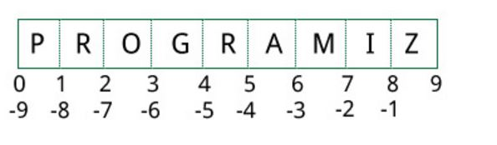
Lists
CHANGEABLE Sequences of Data
Syntax:
list_name = [item1, item2]
Lists are created by using square brackets:
breakfast = [ “coffee”, “tea”, “toast”, “egg” ]
Indexing mechanism:
It starts from 0
From back it starts from -1

Slide 24
Basic Operations
Python Expression | Results | Description
len([1, 2, 3]) | 3 | Length
[1, 2, 3] + [4, 5, 6] | [1, 2, 3, 4, 5, 6] | Concatenation
['Hi!'] * 4 | ['Hi!', 'Hi!', 'Hi!', 'Hi!'] | Repetition
3 in [1, 2, 3] | True | Membership
for x in [1, 2, 3]: print x, | 1 2 3 | Iteration

Slide 25
Indexing, Slicing
Suppose
>>> L=[‘welcome’ , ’to’ , ’python’]
Python Expression | Results | Description
L[2] | ‘python’ | Offsets start at zero
L[-2] | ‘to' | Negative: count from the right
L[1:] | [‘to', ‘python'] | Slicing fetches sections

Slide 26
Python List Methods
append() | Add an element to the end of the list
extend() | Add all elements of a list to the another list
insert() | Insert an item at the defined index
remove() | Removes an item from the list
pop() | Removes and returns an element at the given index
clear() | Removes all items from the list
index() | Returns the index of the first matched item
count() | Returns the count of number of items passed as an argument
sort() | Sort items in a list in ascending order
reverse() | Reverse the order of items in the list
copy() | Returns a shallow copy of the list

Slide 27
Built-In Functions
Function | Description
all() | Return True if all elements of the list are true (or if the list is empty).
any() | Return True if any element of the list is true. If the list is empty, return False.
enumerate() | Return an enumerate object. It contains the index and value of all the items of list as a tuple.
len() | Return the length (the number of items) in the list.
list() | Convert an iterable (tuple, string, set, dictionary) to a list.
max() | Return the largest item in the list.
min() | Return the smallest item in the list
sorted() | Return a new sorted list (does not sort the list itself).
sum() | Return the sum of all elements in the list.

Slide 28
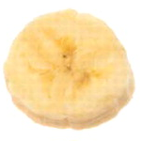
The Repetition Operator and Iterating over a List
Repetition operator: makes multiple copies of a list and joins them together
The * symbol is a repetition operator when applied to a sequence and an integer
Sequence is left operand, number is right
General format: list * n
You can iterate over a list using a for loop
Format: for x in list:

Slide 29
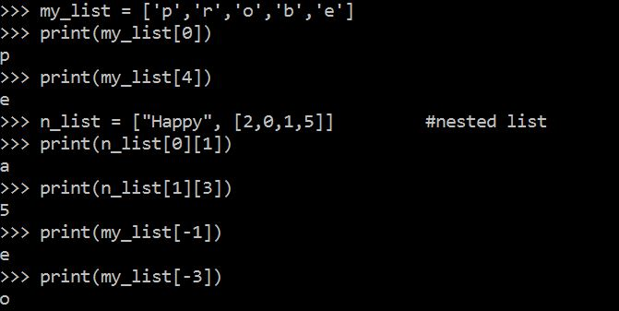
Indexing
Index: a number specifying the position of an element in a list
Enables access to individual element in list
Index of first element in the list is 0, second element is 1, and n’th element is n-1
Negative indexes identify positions relative to the end of the list
The index -1 identifies the last element, -2 identifies the next to last element, etc.

Slide 30
List Slicing
Slice: a span of items that are taken from a sequence
List slicing format: list[start : end]
Span is a list containing copies of elements from start up to, but not including, end
If start not specified, 0 is used for start index
If end not specified, len(list) is used for end index
Slicing expressions can include a step value and negative indexes relative to end of list

Slide 31
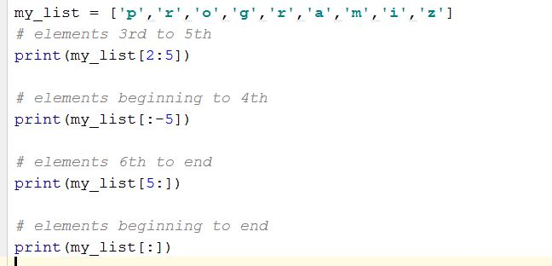
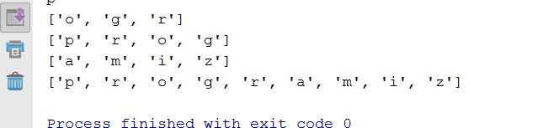
Slicing Examples
Output
Input

Slide 32
List Methods and Useful Built-in Functions (cont’d.)
insert(index, item): used to insert item at position index in the list
sort(): used to sort the elements of the list in ascending order
remove(item): removes the first occurrence of item in the list
reverse(): reverses the order of the elements in the list

Slide 33
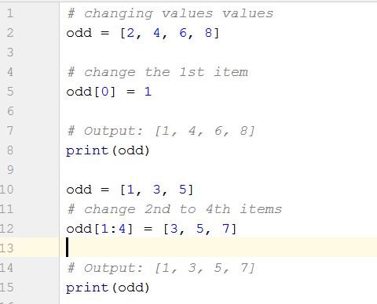

Changing Elements
List are mutable, meaning, their elements can be changed unlike string or tuple.
We can use assignment operator (=) to change an item or a range of items.
list[1] = new_value can be used to assign a new value to a list element
Must use a valid index to prevent raising of an IndexError exception
Output

Slide 34
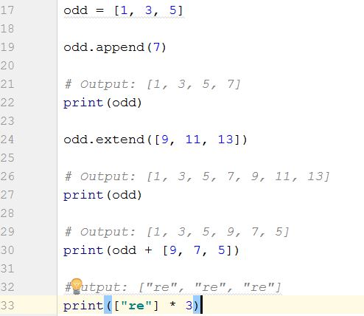
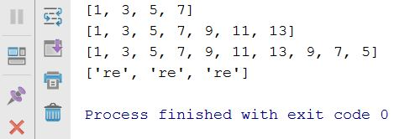
Addition
We can add one item to a list using append() method or add several items using extend()method
Output
We can also use + operator to combine two lists. This is also called concatenation.
The * operator repeats a list for the given number of times.

Slide 35
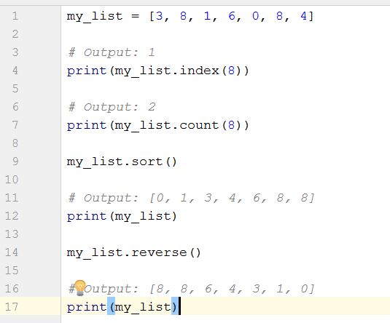
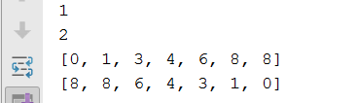
Other built in function Examples
Output

Slide 36
List Methods and Useful Built-in Functions (cont’d.)
del statement: removes an element from a specific index in a list
General format: del list[i]
min and max functions: built-in functions that returns the item that has the lowest or highest value in a sequence
The sequence is passed as an argument

Slide 37
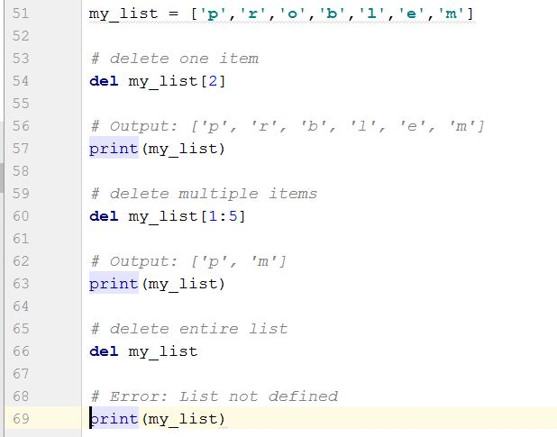
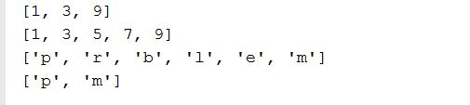
Deletion
Output

Slide 38
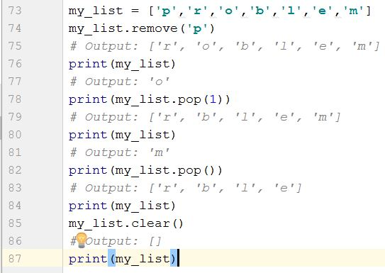
Continued…
We can use remove() method to remove the given item
or pop() method to remove an item at the given index.
The pop() method removes and returns the last item if index is not provided.
This helps us implement lists as stacks (first in, last out data structure).
We can also use the clear() method to empty a list.

Slide 39
Finding Items in Lists with the in Operator
You can use the in operator to determine whether an item is contained in a list
General format: item in list
Returns True if the item is in the list, or False if it is not in the list
Similarly you can use the not in operator to determine whether an item is not in a list

Slide 40
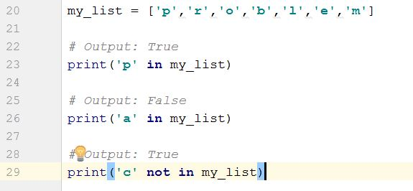

Continued…
Output

Slide 41
Copying Lists
To make a copy of a list you must copy each element of the list
Two methods to do this:
Creating a new empty list and using a for loop to add a copy of each element from the original list to the new list
Creating a new empty list and concatenating the old list to the new empty list

Slide 42
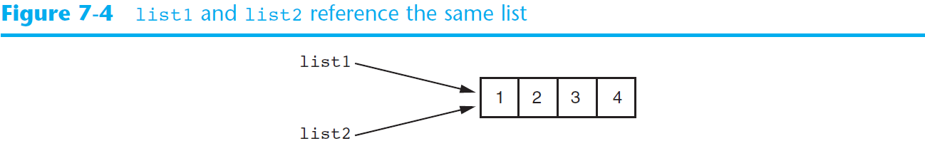
Copying Lists (cont’d.)

Slide 43
Two-Dimensional Lists
Two-dimensional list: a list that contains other lists as its elements
Also known as nested list
Common to think of two-dimensional lists as having rows and columns
Useful for working with multiple sets of data
To process data in a two-dimensional list need to use two indexes
Typically use nested loops to process

Slide 44
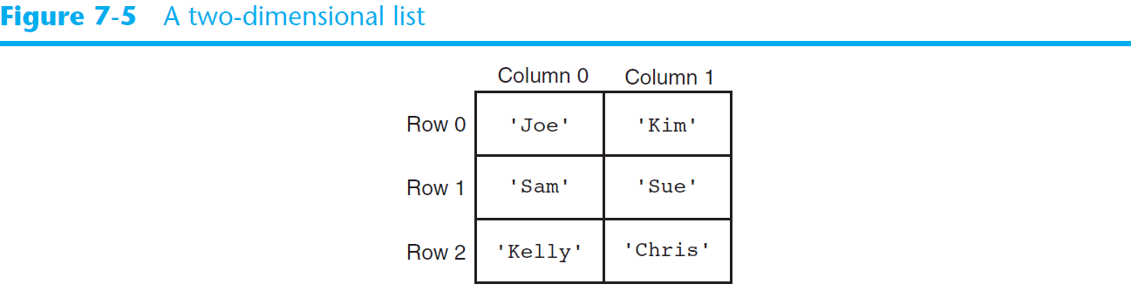
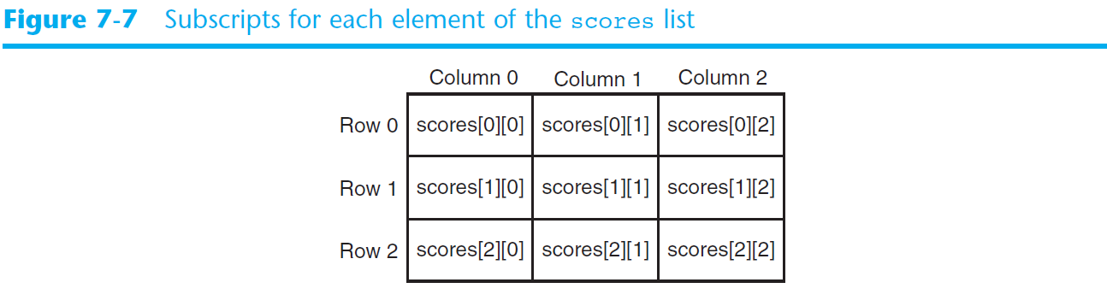
Two-Dimensional Lists (cont’d.)

Slide 45
Tuples
UNCHANGABLE Sequences of Data
Syntax:
tuple_name = (item1, item2)
Enclosed in parentheses:
Example: tuple1 = (“This”, “is”, “a”, “tuple”)
They have elements which are indexed starting at 0
A tuple with a single element must have a comma inside the parentheses:
a = (11,)

Slide 46
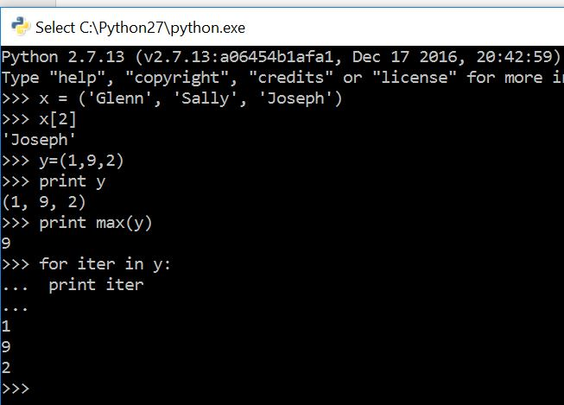
Tuples
X[2] prints the third element in the tuple
Notice max function

Slide 47
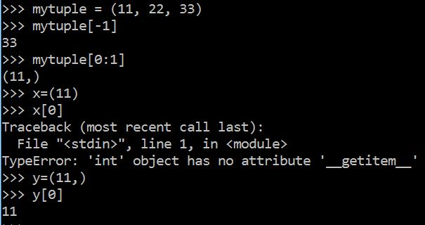
More examples
Notice -1 index
(11) Acts as integer whereas (11,) acts as sequence

Slide 48
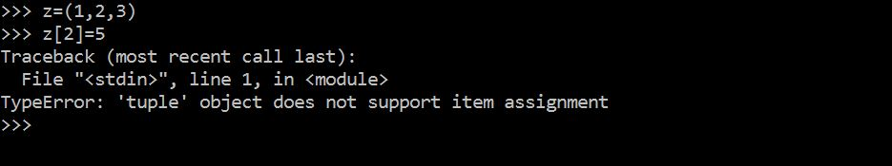
..but.. Tuples are "immutable"
Unlike a list, once you create a tuple, you cannot alter its contents - similar to a string

Slide 49
Operations
Tuples support operations as lists
Subscript indexing for retrieving elements
Methods such as index
Built in functions such as len, min, max
Slicing expressions
The in, +, and * operators
Tuples do not support the methods:
Append, remove, insert, reverse, sort

Slide 50
Basic Operations
Suppose
>>> tup1=(1,2,3)
>>>>tup2=(4,5,6)
>>>tup3=(‘Hi’,)
Python Expression | Results | Description
len(tup1) | 3 | Length
tup1 + tup2 | (1, 2, 3, 4, 5, 6) | Concatenation
tup3* 4 | ('Hi!', 'Hi!', 'Hi!', 'Hi!') | Repetition
3 in tup1 | True | Membership
for x in tup1: print x, | 1 2 3 | Iteration

Slide 51
Indexing, Slicing
Suppose
>>> L=(‘welcome’ , ’to’ , ’python’)
Python Expression | Results | Description
L[2] | ‘python’ | Offsets start at zero
L[-2] | ‘to' | Negative: count from the right
L[1:] | [‘to', ‘python'] | Slicing fetches sections
Same as String

Slide 52
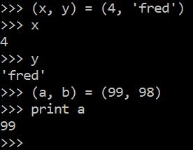
Tuples and Assignment
We can also put a tuple on the left hand side of an assignment statement
We can even omit the parenthesis

Slide 53
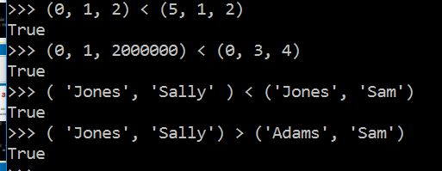
Tuples are Comparable
The comparison operators work with tuples and other sequences If the first item is equal, Python goes on to the next element, and so on, until it finds elements that differ.

Slide 54
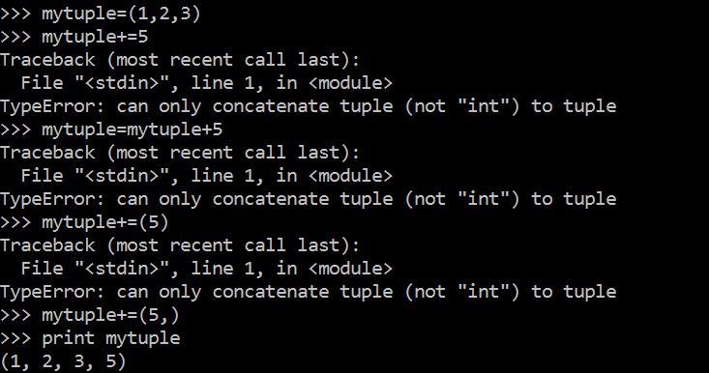
Concatenation
This is how concatenation works

Slide 55
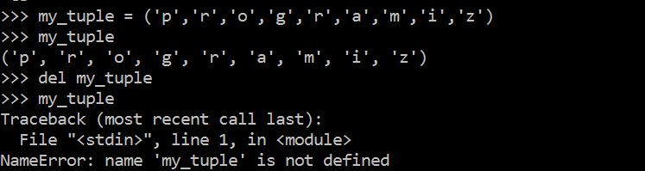
Deleting Tuple
As tuple is already deleted

Slide 56
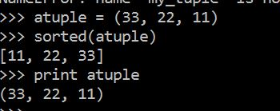
Sorting tuples
sorted( ) returns a list!

Slide 57
Built In Functions
Function | Description
all() | Return True if all elements of the tuple are true (or if the tuple is empty).
any() | Return True if any element of the tuple is true. If the tuple is empty, return False.
enumerate() | Return an enumerate object. It contains the index and value of all the items of tuple as pairs.
len() | Return the length (the number of items) in the tuple.
max() | Return the largest item in the tuple.
min() | Return the smallest item in the tuple
sorted() | Take elements in the tuple and return a new sorted list (does not sort the tuple itself).
sum() | Retrun the sum of all elements in the tuple.
tuple() | Convert an iterable (list, string, set, dictionary) to a tuple.

Slide 58
Tuples are more efficient than lists
We generally use tuple for heterogeneous (different) datatypes and list for homogeneous (similar) datatypes.
Since tuple are immutable, iterating through tuple is faster than with list. So there is a slight performance boost. They are more simpler in nature.
Tuples that contain immutable elements can be used as key for a dictionary. With list, this is not possible.
If you have data that doesn't change, implementing it as tuple will guarantee that it remains write-protected.

Slide 59
Python Functions
A function is a piece of code that performs a task of some kind.
A function has a name that is used when we need for the task to be executed. Asking that the task be executed is referred to as “calling” the function.
Some functions need one or more pieces of input when they are called. Others do not.
Some functions give back a value; others do not. If a function gives back a value, this is referred to as “returning” the value.

Slide 60
Defining Functions
Function definition begins with “def.”
Function name and its arguments.
def get_final_answer(filename):
“““Documentation String””” line1
line2
return total_counter
The indentation matters…
First line with less indentation is considered to be outside of the function definition.
The keyword ‘return’ indicates the value to be sent back to the caller.
No header file or declaration of types of function or arguments

Slide 61
Calling a Function
The syntax for a function call is:
>>> def myfun(x, y):
return x * y
>>> myfun(3, 4)
12
Parameters in Python are Call by Assignment
Old values for the variables that are parameter names are hidden, and these variables are simply made to refer to the new values
All assignment in Python, including binding function parameters, uses reference semantics.

Slide 62
Functions without returns
All functions in Python have a return value, even if no return line inside the code
Functions without a return return the special value None
None is a special constant in the language
None is used like NULL, void, or nil in other languages
None is also logically equivalent to False
The interpreter’s REPL doesn’t print None

Slide 63
Function overloading? No.
There is no function overloading in Python
Unlike C++, a Python function is specified by its name alone
The number, order, names, or types of arguments cannot be used to distinguish between two functions with the same name
Two different functions can’t have the same name, even if they have different arguments

Slide 64
Default Values for Arguments
You can provide default values for a function’s arguments
These arguments are optional when the function is called
>>> def myfun(b, c=3, d=“hello”): return b + c
>>> myfun(5,3,”hello”)
>>> myfun(5,3)
>>> myfun(5)
All of the above function calls return 8

Slide 65
Keyword Arguments
Can call a function with some/all of its arguments out of order as long as you specify their names
>>> def foo(x,y,z): return(2*x,4*y,8*z)
>>> foo(2,3,4)
(4, 12, 32)
>>> foo(z=4, y=2, x=3)
(6, 8, 32)
>>> foo(-2, z=-4, y=-3)
(-4, -12, -32)
Can be combined with defaults, too
>>> def foo(x=1,y=2,z=3): return(2*x,4*y,8*z)
>>> foo()
(2, 8, 24)
>>> foo(z=100)
(2, 8, 800)

Slide 66
Python and Types
Dynamic typing: Python determines the data types of variable bindings in a program automatically
Strong typing: But Python’s not casual about types, it enforces the types of objects
For example, you can’t just append an integer to a string, but must first convert it to a string
x = “the answer is ” # x bound to a string
y = 23 # y bound to an integer.
print x + y # Python will complain!

Slide 67
Functions are first-class objects
Functions can be used as any other datatype, eg:
Arguments to function
Return values of functions
Assigned to variables
Parts of tuples, lists, etc
>>> def square(x): return x*x
>>> def applier(q, x): return q(x)
>>> applier(square, 7)
49

Slide 68
Use case: Car Rental

Slide 69
Use case: Car Rental
The goal of this use case is to calculate the money one should pay when renting a car.
Surely this money will be affected by the kind of car, distance, kind of petrol, number of days…
So in this use case, there is a couple of questions that a user answers then the amount of money one should pay will be printed.

Slide 70
Useful functions for doing this example
Raw_input(): interact with the outside world to get input, It has been in python 2.7 for getting string, now we can use the input in python 3.
Quit(): here we used this function to exit of the loop when the user press q.
Not in : check to see if the input is not in a list or Array
Global: module scope

Slide 71
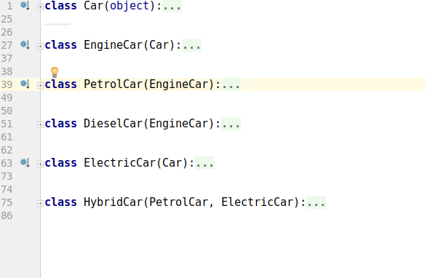
Module cars
It contains six classes which helps to choose various features of a car for hiring

Slide 72
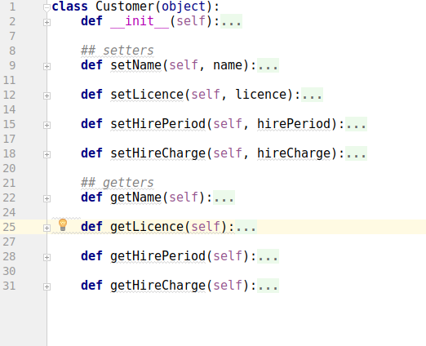
Module customer
This module includes some classes about the detailed information of the customer

Slide 73
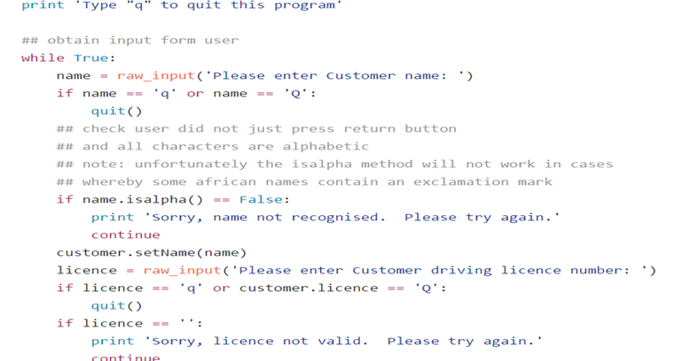
Getting information of the customer

Slide 74
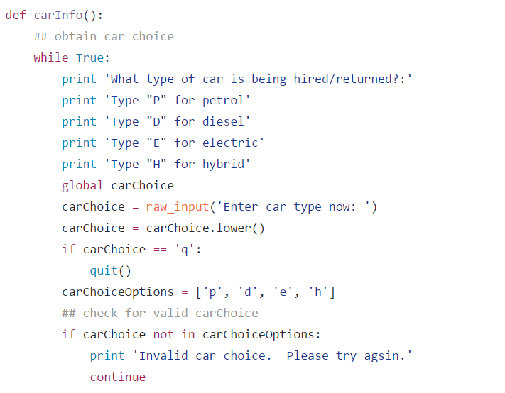
Choosing one of the car options available

Slide 75
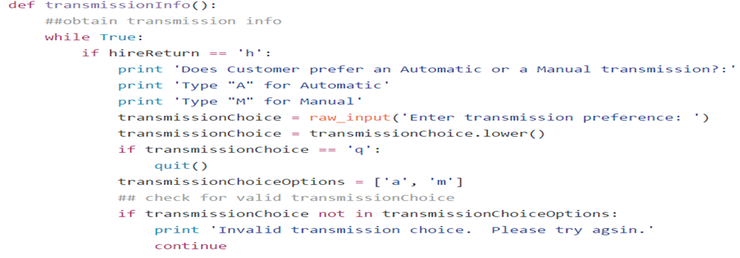
Automatic or Manual car

Slide 76
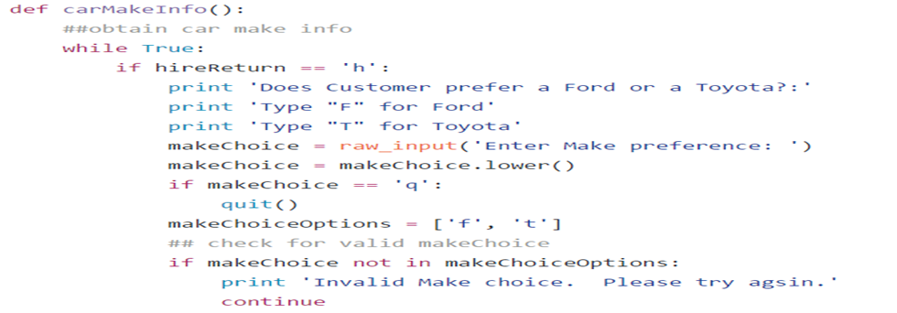
Ford Or Toyota

Slide 77
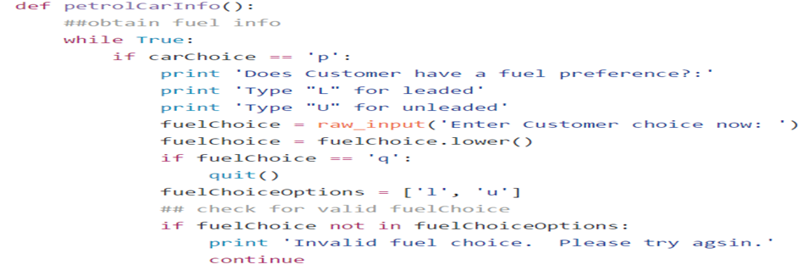
Fuel Preference

Slide 78
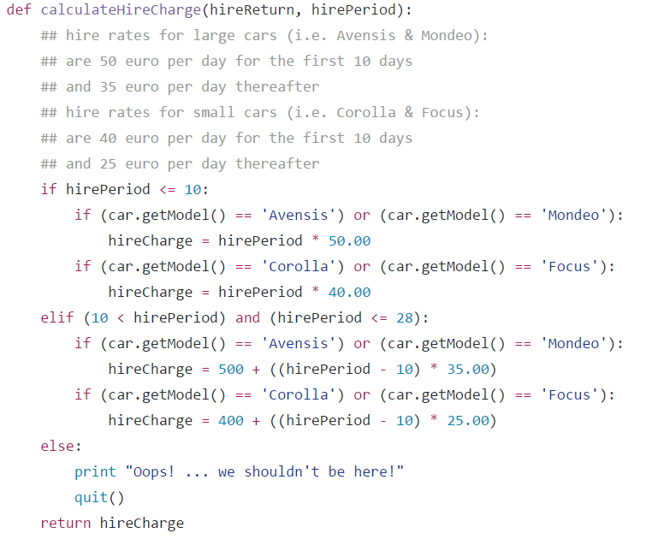
Rates of hiring

Slide 79
References
https://github.com/wade12/ProgrammingForBigDataCA2CarRental/blob/master/carRentalApp.py
http://www.w3resource.com/python-exercises/python-conditional-statements-and-loop-exercises.php
https://www.learnpython.org/

Slide 80
Thank you

